Slide 1

Ortho Eyes
Tim bekema
Beau fiechter
Donna van grunsven
Jasmijn Heupers
Emma korf
Danny vink

Slide 2
Table of contents
Recap
What did we do?
Results OR-ensemble
What will we do next?
Questions

Slide 3
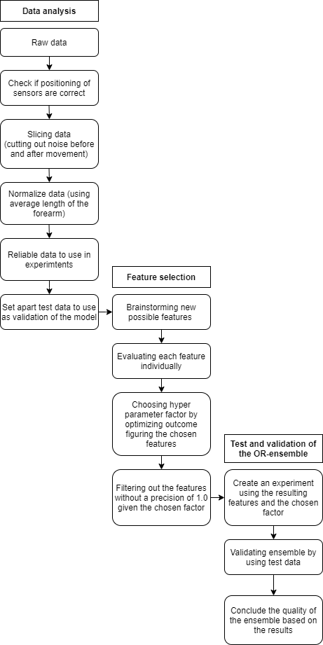
Recap
The research question
Which models can be added to the OR-ensemble to improve the classification of individuals to the correct patient group using the existing data from a Flock of Birds system?

Slide 4
What did we do?
Feature selection is finished
Researched other ensemble methods
Applied those on the definitive feature set
Writing the paper
- Other methods
- Justify chosen features

Slide 5
Results OR-ensemble
2, 3, 4 vs. 1
Precision 1.0
Recall 0.98
Accuracy 0.98
2, 3 vs. 4
Precision 1.0​
Recall 0.66
Accuracy 0.79
2 vs. 13
Precision 1.0​
Recall 0.49
Accuracy 0.75

Slide 6
What will we do next?
Test the OR-ensemble using test data
Finish up the paper
Rewriting the introduction
Write ‘Data’ chapter
Explaining the raw data and how it was cleaned
Finish ‘Analysis’ chapter
Explaining the interpretability of the ensemble and the feature selection including medical justification
Write ‘Model’ chapter
Explaining the factor (hyperparameter) and the concept of the ensemble and how it works
Correct and perfect the ‘Results’ chapter
Write ‘Conclusion’
Create visual aids for the paper where needed

Slide 7
Any Questions?

